Slide 3
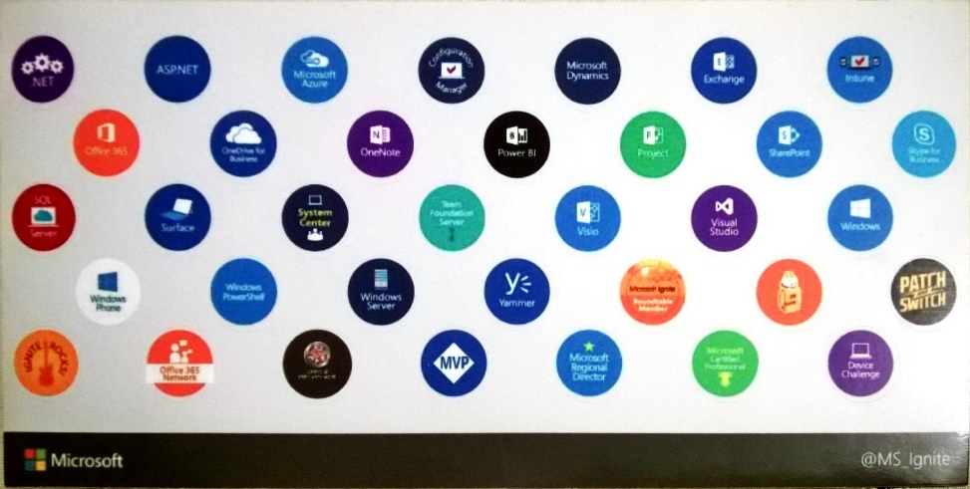
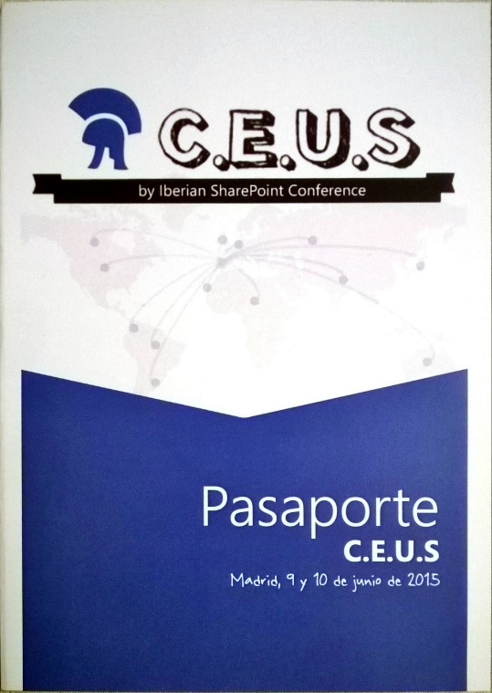

¡Completa tu pasaporte!
Debes recorrer todos los stand de la conferencia
Solicita en cada stand su pegatina
Pégalas todas en el pasaporte
Una vez relleno, solicita a la azafata del mostrador interno (al lado del auditorio) tu número de participación
¡El pasaporte completo te permitirá participar en el sorteo de los regalos de la conferencia!

Slide 4




Edin Kapić
SOGETI
SharePoint Practice Lead
MVP SharePoint Server
http://www.edinkapic.com
http://www.sug.cat
@ekapic

Slide 5
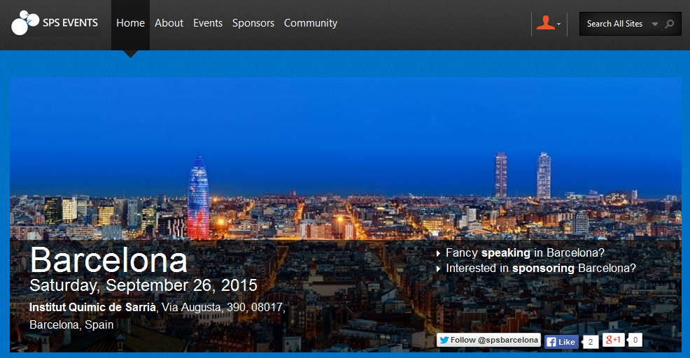
http://www.spsevents.org/city/Barcelona/Barcelona2015/
http://www.spsevents.org/city/Barcelona/Barcelona2015/

Slide 6
Aplicaciones High-Trust de SharePoint 2013

Slide 7
High-Trust Apps?

Slide 8
Agenda
SharePoint app model review
High-trust apps mechanism
DEMO
Advanced scenarios

Slide 9
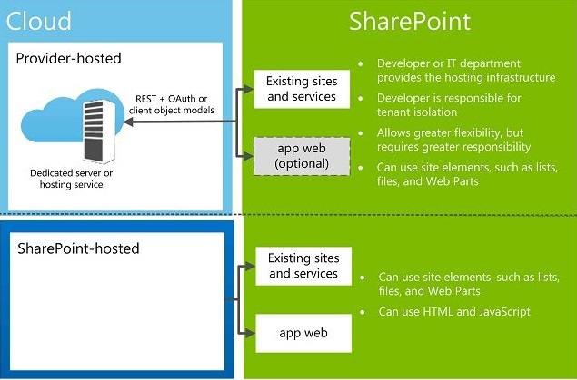
SharePoint “cloud apps model”
SharePoint-hosted apps
Provider-hosted apps (remote apps)

Slide 10
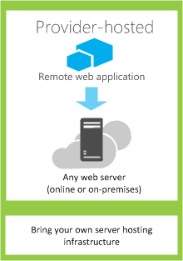
Provider-hosted apps
The code runs in a separate server
Uses REST/CSOM API to call SharePoint
Uses OAuth for authorization

Slide 11

App authentication
Apps are now first class security principals
They have their own identity and permissions
App authentication only happens on REST/CSOM endpoints

Slide 12
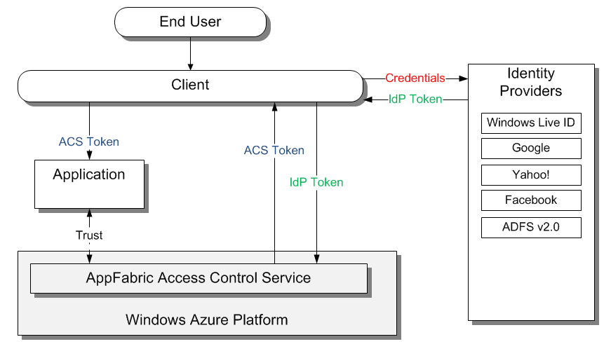

App authentication methods
OAuth
Brokered by Access Control Service (ACS)
Server-to-server
Using SSL certificates

Slide 13
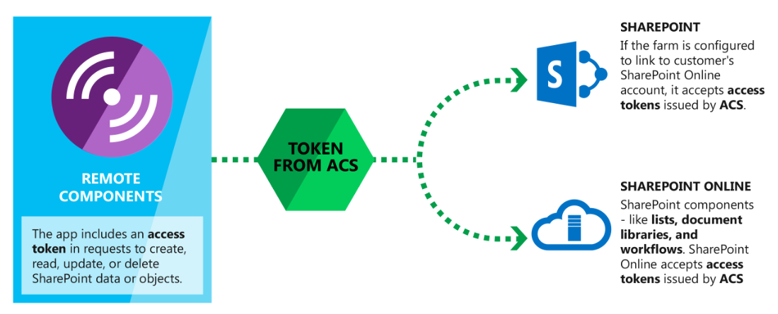
Low-trust app authentication

Slide 14
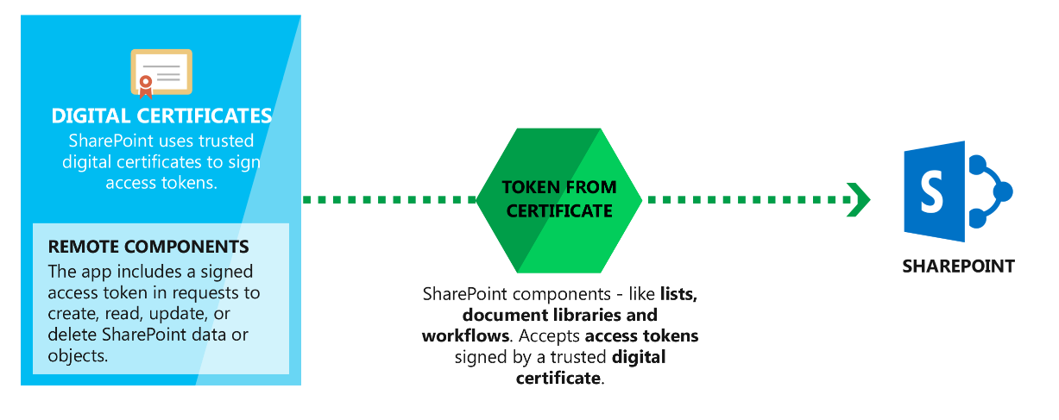
High-trust app authentication

Slide 15
High trust != Full trust
It means that the app is ensuring the user token part

Slide 16
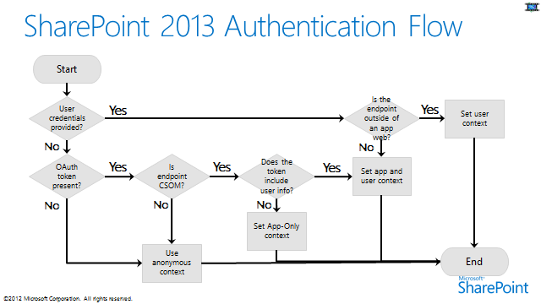

Slide 17
High-trust app prerequisites
SSL certificate
Configure Trusted Root Authority
Configure Trusted Token Issuer
Secure Token Service
User profiles

Slide 18
High-trust mechanism
App has x.509 certificate with public/private key pair
Private key used to sign certain aspects in access token
Public key registered with SharePoint farm
This creates a trusted security token issuer
App creates access token to call into SharePoint
App creates access token with a specific client ID and signs it with private key
Trusted security token issuer validates signature
SharePoint establishes app identity
App identity maps to a specific client ID
You can have many client IDs associated with a single x.509 certificate
Source: Ted Pattison SPC12 talk

Slide 19
Demo: App High-Trust

Slide 20
Gotchas
Provider-hosted app authentication (Windows, SAML, fixed…)
SharePoint host web application mode (Claims, Classic-Windows) can cause auth failures
TokenHelper uses Active Directory SID as the identifier
App-only tokens are not supported by all API areas

Slide 21
Advanced scenarios

Slide 22
Using other authentication methods
TokenHelper uses WindowsIdentity under the covers
Custom code for SAML Federated Authentication contributed by Wictor Wilén (http://bit.ly/1aFponK)
FBA is also supported

Slide 23
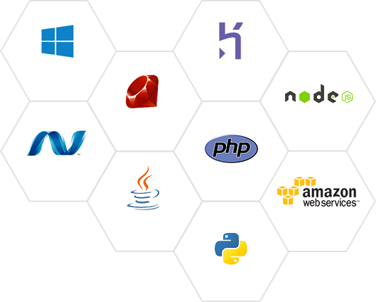
Using other technology stacks
Overview of options by Kirk Evans http://bit.ly/1jK3Evh
Java, PHP, Node.js
JWT token creation
Token signing with X.509 certificate

Slide 24
Extending the TokenHelper code
TokenHelper is just code, you can edit and extend it
Retrieving app parameters from a database
Caching access tokens
Creating custom user identity
Extending token lifetime
Retrieving certificates from a repository

Slide 25
My recent project
3 provider-hosted apps (2 MVC, 1 Lightswitch)
SharePoint 2013 back-end platform
2 types of users
Windows
Online Banking
Public App (SAML)
Internal App (Windows)
Admin App (Windows)
Online Bank IdP
Claims Web App
Classic Web App
SharePoint 2013

Slide 26
Summary

Slide 27
High-trust apps in SharePoint 2013
Alternative for on-premises app development
Cloud-ready code
More flexible than the low-trust apps

Slide 28
Useful information sources about HTA
Kirk Evans http://blogs.msdn.com/b/kaevans/
Steve Peschka http://blogs.technet.com/b/speschka/
Wictor Wilén http://www.wictorwilen.se

Slide 29
Q&A

Slide 30

¡Rellena tu encuesta!
No olvides rellenar las dos hojas de encuesta.
Una vez relleno, entrégala a la azafata del mostrador interno (al lado del auditorio).
La azafata te entregará la bolsa con el regalo de la conferencia.

